Slide 1

Contacts App

Slide 2
Problem
These days losing a mobile phone has been a very common thing which happens for one in a ten, here comes the problem of losing valuable contact information. The main challenge here is although anyone loses his mobile phone current system should support saving contact information in a log file in XML or EXCEL format and mail the same on daily or weekly or monthly as per the user interest (through triggering concept).

Slide 3
Aim
The main aim of the project is to develop an application (ANDROID) which can support saving contacts on to a mobile phone (SMART PHONE WHICH ANDROID OS) in a specified format and send the same to a specified email address.

Slide 4
Objectives of Research
The objectives of the project can be framed as follows:
Save contacts in a specified file format (XML or EXCEL)
Design an application in ANROID which can do this job of saving the contacts and sending the same to a specified email address.
Configuring this android application (Contact App) on to a mobile phone which supports ANDROID Operation System.

Slide 5
Solution
Solution for this current problem is developing an application for the mobile platform (android) and deploying it on any mobile which has android operating system and saving the contacts as specified.

Slide 6
Features of the project
Save the contacts in a specified file format (XML or EXCEL)
User can set the email address to which the contacts have to be emailed.
User can set the triggering time, when the contacts have to be emailed (Weekly, daily or monthly).
Contact App can be used for a mobile only once i.e.when it is installed it asks for mobile number and an email id as UNIQUE keys and registers them at a server and the same application cannot be used with the same mobile number in another phone (commercial advantage).

Slide 7
Hardware and Software Requirements
Hardware:
Any smart phone which supports ANDROID OS
Software:
Java, Android SDK and eclipse IDE.

Slide 8
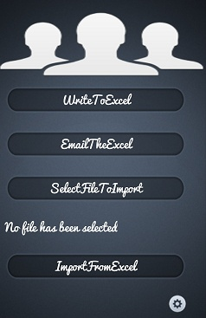
Save Contacts in Excel Format

Slide 9
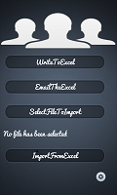
Import/Export Contacts to Xls Format

Slide 10
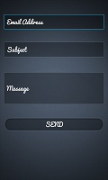
Email to a specific Email address

Slide 11
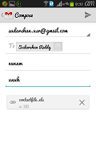
Emailing Through Gmail App

Slide 12
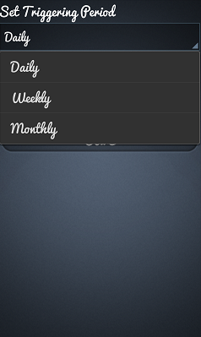
Email Sending Triggering time

